Slide 1
Lesson 1 WHERE is the Earth Changing? Student Activity
You will follow the directions to complete Activities 1.1 and 1.2 with your partner!
Activity 1.1:Worldwide Pattern of Volcanoes
Activity 1.2: Worldwide Pattern of Earthquakes
Reading 1.2: Volcanoes and Earthquakes

Slide 2
1.1 World Wide Patterns of Volcanoes (p. 2)
Discuss with a partner and answer in box we created on the bottom of p. 2:
What do you know or have you heard about volcanoes?
Where do you think volcanoes are usually found?
Watch Videos
Mount St. Helens https://www.youtube.com/watch?v=8eO-7qm7fiY
Kilauea, HI https://www.youtube.com/watch?v=5KoJowe8Q8Q
Notes:
Find a link
Julie
7 minute Mt St Helen’s Video https://www.youtube.com/watch?v=SJA27Bp1q58
1-2 min Kilauea https://www.youtube.com/watch?v=BtH79yxBIJI and https://www.youtube.com/watch?v=5ItzvDg9Cjs
Drones taking video footage https://www.youtube.com/watch?v=zFIWWM0Iv-U

Slide 3
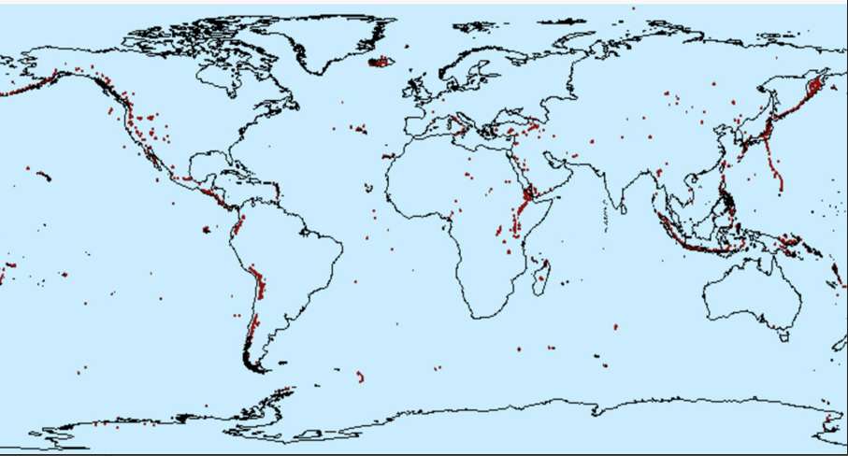
Volcano Locations
2. Look for patterns in where volcanoes ARE found
3. Then, look for places in which NO volcanoes are found
4. With your group discuss the patterns you observe and about data that
don’t fit the patterns. Answer the Making Sense questions 1 & 2 on page 2.

Slide 4
1.2 World Wide Patterns of Earthquakes (p. 3)
Discuss with a partner and answer in the box on top of page 3:
What do you know or have you heard about earthquakes?
Where do you think earthquakes typically occur?
Watch Video National Geographic Montage https://video.nationalgeographic.com/video/earthquake-montage
Notes:
https://video.nationalgeographic.com/video/earthquake-montage

Slide 5
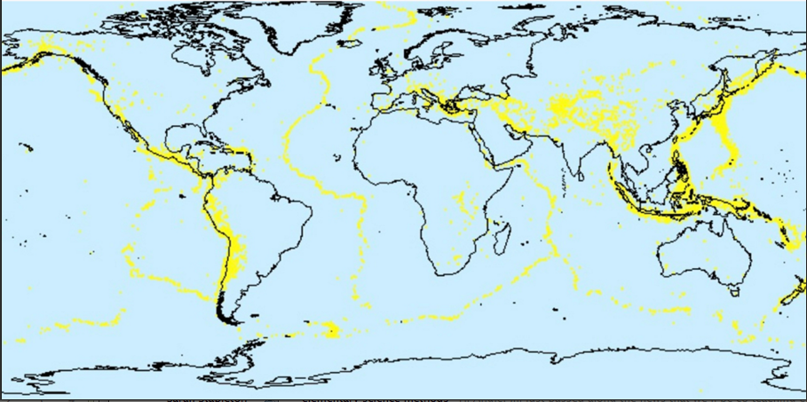
Earthquake Locations
2. Look for patterns in where earthquakes ARE found and NOT found.
3. Talk with your group about the patterns you observe and about data
that don’t seem to fit the patterns.
4. Answer Making Sense questions 1-3 on page 4.
Notes:
TG 14-15 SB 3#’s 1-4

Slide 6
Comparing Earthquakes and Volcanoes
Work as a pair:
One person has the volcano map on their iPad
One person has the earthquake map on iPad
Discuss #4-#6 on page 4:
What patterns do you see in areas where E and V occur?
What data does not seem to fit the patterns?
Notes:
TG In their pair one student should have volcano map on iPad and other should have the earth quake map. Discuss

Slide 7
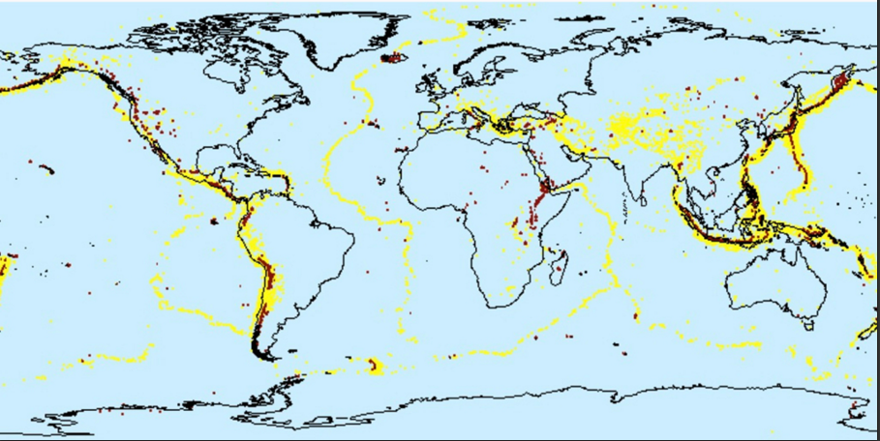
Earthquake and Volcano Locations
What do you notice about the location of earthquakes and volcanoes?
What patterns can you identify?
Are there locations that don’t fit the patterns?
Answer questions 4-6 on page 4.
Notes:
TG p. 15—Have a Pressing for Understanding Discussion get to: V and E occur in similar locations, earthquakes more common

